Slide 1

Stock Market Time Series
S&P 500
Francis Odo

Slide 2
Exploratory Phase
Note: Preliminary work is currently in progress. This phase is considered exploratory. Basic layout of modeling and analysis to follow.

Slide 3
Data Time Series
Compiled stock performance data
Period – Five years

Slide 4
Type and Size of Data
Data is collected over a 5 yr. period
Comma Separated Value format (CSV)
Seven Columns of inputs / Features About 3,777 Rows

Slide 5
Features Before Preprocessing
Date (Index)
Open (Opening price)
High (Highest trading price of the day)
Low (Lowest trading price of the day)
Close (Closing price of the day)
Volume (Trading volume of the day)
Name (Ticker Symbol)

Slide 6
Why Stock Data
NONLinear
Data has ideal structure for modeling
Quantifiable Key Performance Index

Slide 7
Source of Data
Kaggle.com

Slide 8
Questions to which answers are offered
Trend
Is there an upward or downward trend?
Pattern
Is there a pattern that repeats?
Seasonality or Stationarity?

Slide 9
Data Characteristics and its Nature
Observation taken sequentially in time
Time-Series model capable of forecasting the future based on learned patterns
Non-stationary input data(statistical key metrics (mean/standard deviation) varies over time
The output variable depends linearly on its own previous values

Slide 10
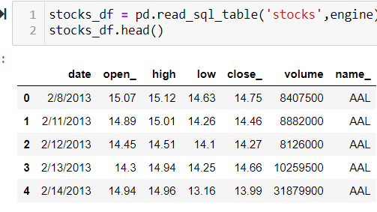
Dataset Preview

Slide 11
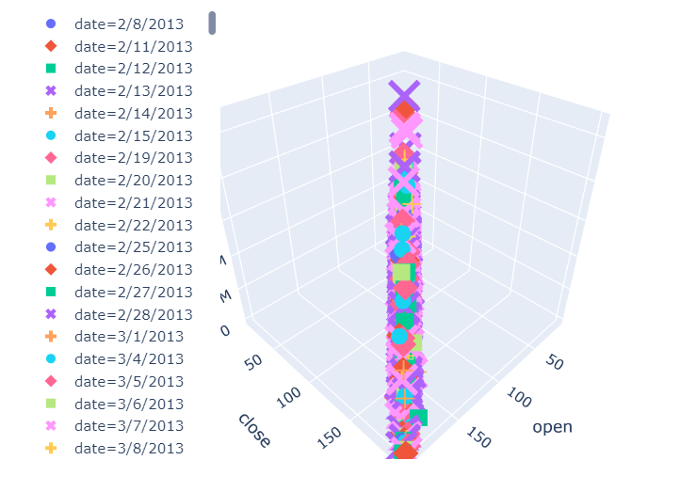
Visualization - Cluster

Slide 13
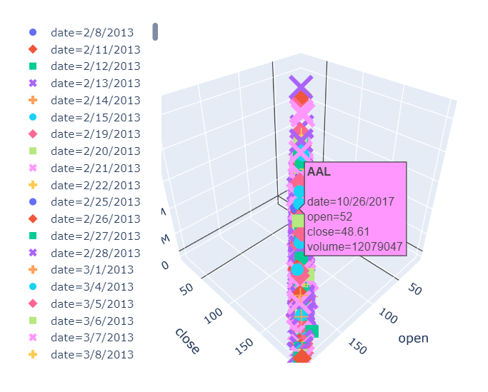
Principal Component - AAPL

Slide 14
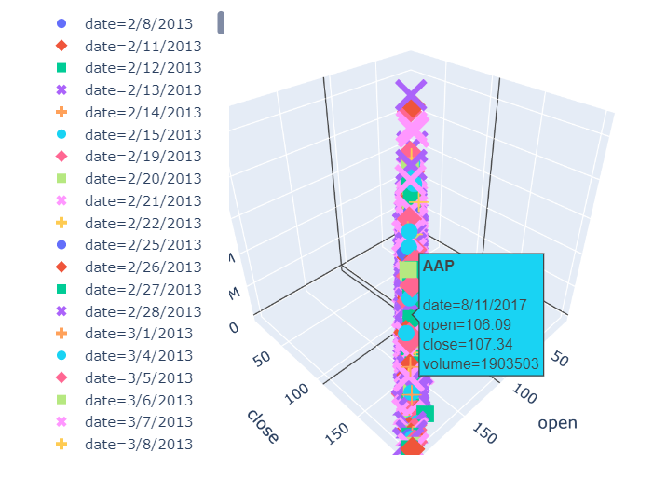
Principal Component - AAP

Slide 15
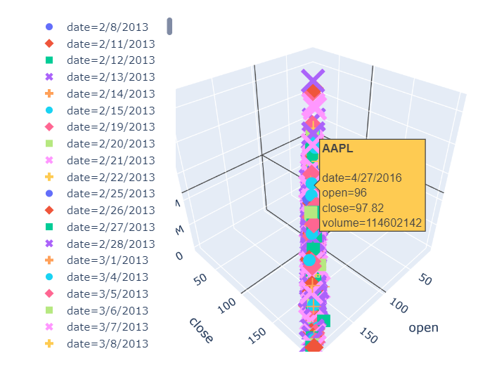
Principal Component - AAPL

Slide 16
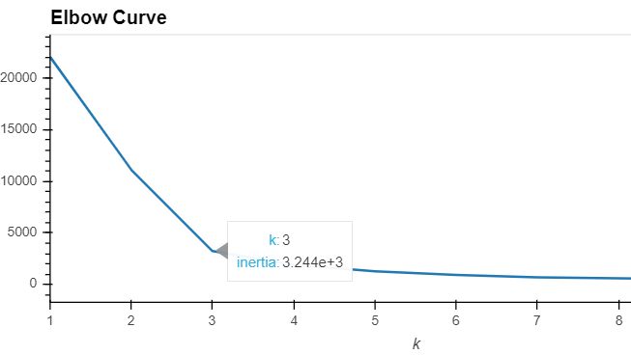
KMeans - Elbow Curve K=3

Slide 17
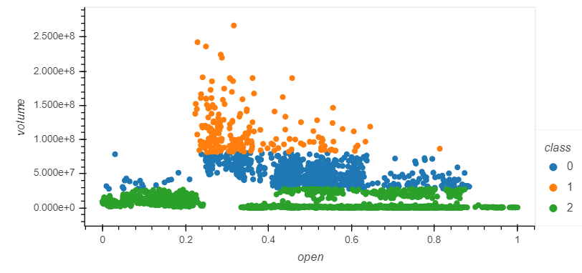
Cluster - Classification

Slide 18
Database Integration
Jupyter Notebook
Postgres SQL DB

Slide 19
Machine Learning Model
Supervised Learning
Regression
Prediction

